Slide 1
Making
CLLD & ITI a success for Roma Inclusion in 2021-2027 Cohesion Programmes

Slide 2
PA PO 5 sustainable & integrated development of urban, rural & coastal areas & local initiatives
Integrated Territorial Investment
  regional packages of interconnected & complementary integrated projects
    Municipal Plans for Integrated Development
  > 10% ERDF (lead) & ESF+
Community-Led Local Development
  municipalities (10K-150K inhabitants)
  bottom-up implementation, through local initiative groups, who identify & approve priorities, strategies & funding for integrated development
  10% EAFRD (lead), 2% ESF+ & ERDF

Slide 3
CLLD & ITI for Roma Inclusion
In areas with significant marginalized Roma communities, ITI & CLLD should include actions targeting their needs & development potential

Slide 4
ESF+ €105 million for Roma inclusion at local level | Education |  | HRD |  | Total
 | CLLD | ITI | CLLD | ITI
Socio-economic integration of marginalised Roma communities | 15,0 | 11,0 | 11,8 | 67,2 | 105,0

Slide 5
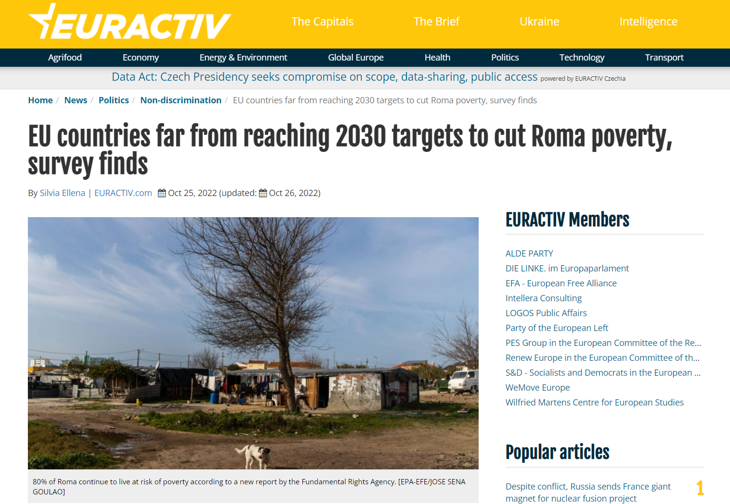
High time to make progress …

Slide 6
Towards an integral approach
need for bottom-up approach
traditional Roma policy
ID
debts
illegal housing
migration
school dropout
Kindergarten
employment
INDIVIDUAL REALITIES
EXTERNAL DIAGNOSTIC
housing
NEET
health
income
soft skills
hard skills
integrated diagnostic & action
gender gap
marginalisation
poverty
municipal staff
municipal assets/debt
mediators
job skills
short-term projects
LAG capacities
Social workers
LOCAL REALITIES
TOP-DOWN GENERIC POLICIES
segregated areas
school
NGO capacities
Child Guarantee
community centres
local economy
social infrastructure
kindergarten
Youth Guarantee
social housing
Notes:
Why is CLLD needed and important to achieve Roma inclusion ?

Slide 7

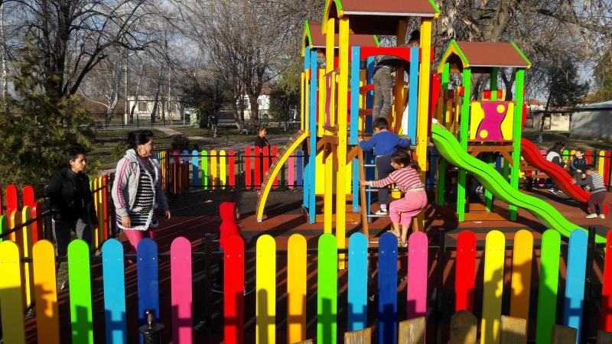
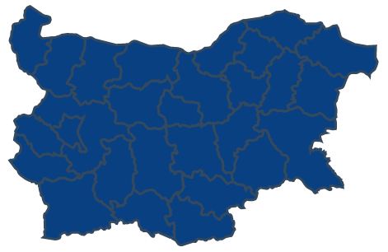
€25,000
invested by ROMACT
/ municipality / year
58
Municipalities
BULGARIA

Slide 8




Key Steps
Committing | Assessing | Planning | Implementing
Mayor, Local Council, local administration, Roma | needs & resources | Local Development Strategy | funding, implementation, monitoring & evaluation
 | Community Action Group / Municipal Roma Task Force | capacity building
Facilitator
Experts | facilitator | Experts

Slide 9
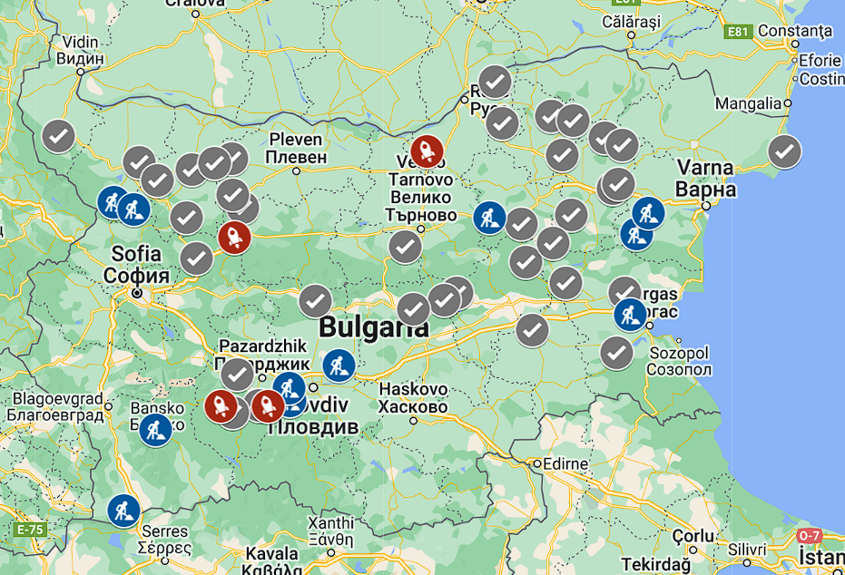
soon in a municipality near you …

Slide 10
Thank you

