Slide 1

Pillar 2: Review for Stakeholders Workshop
June 30, 2021

Slide 2
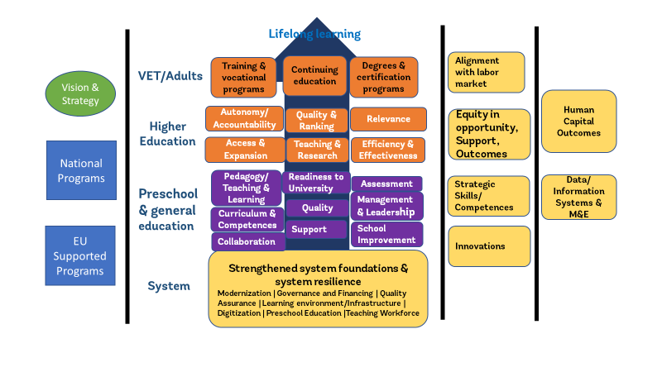
Methodology

Slide 3
Output Status
Deliverables | Date
4.0 Inception report | June 30, 2020
4.1 Three reports on situation analysis of education outcomes with trends and international comparisons | November 30, 2020
4.2 Assessment and recommendations on the learning environments in preschool, general schools and vocational schools in Bulgaria | October 30, 2020
5. A report detailing a proposal for monitoring system of education policy developments and outcomes | April 30, 2021
6.1 Stakeholder consultative workshops for technical experts and decision makers | June 30, 2021
6.2. A report with proposals for policy programs to address the National Strategic Framework in Education 2030 | August 30, 2021
7.1. & 7.2 Assessment report of the first and second draft of the Operational Programme for Education 2021-2027 (ESF part) | December 30, 2020
Final Report for Pillar 2 activities | November 30, 2021
Green = submitted and approved | yellow = submitted & under review | no color = not yet due

Slide 4
Output 4.1: Situation Analysis
The situational analysis provides the analytical basis for the development of future strategies, priorities, and activities, including the design and implementation of EU-financed support to this area.
Situation analysis is comprised of 3 Reports addressing the 5 subsectors:
VET & LLL | ECE & General Education | Higher Education

Slide 5
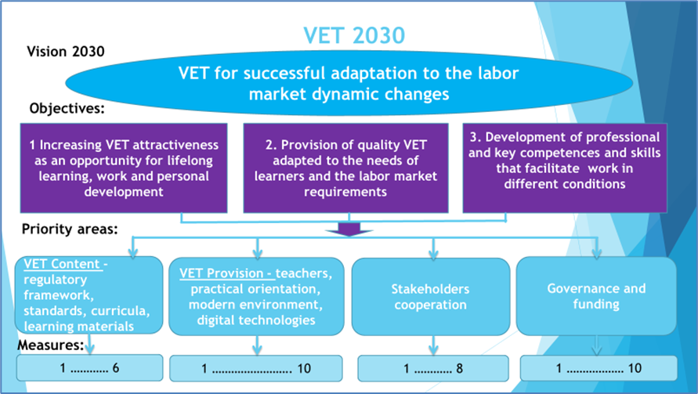
Output 4.1 VET: Situation Analysis
System approach to VET as reflected in the EP21-27 which should be mirrored in national programs

Slide 6
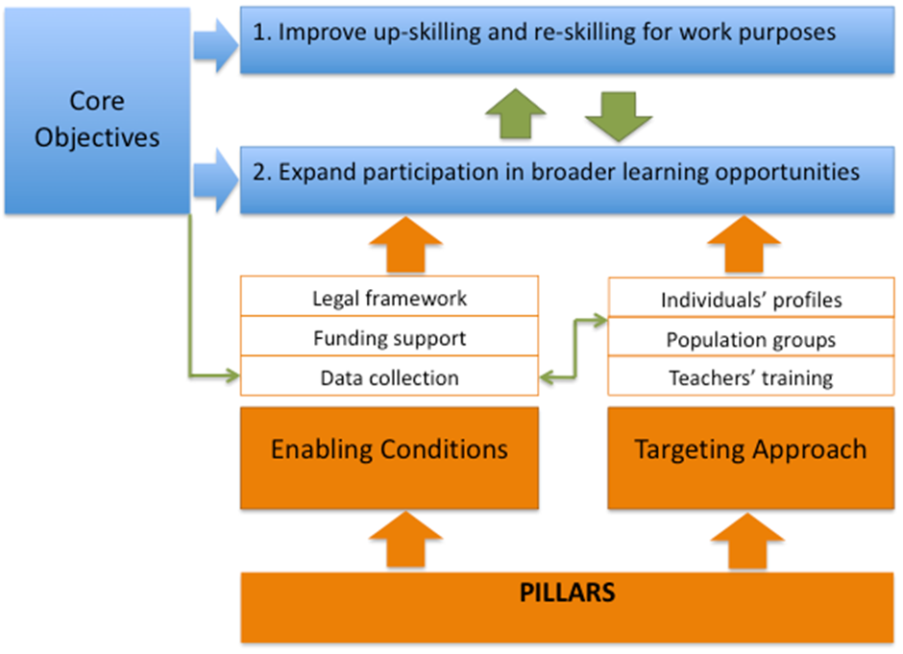
Output 4.1 LLL: Situation Analysis
System approach and action plan for adult education and learning

Slide 7
Output 4.1 Higher Education: Situation Analysis
Address the fragmentation of the system keeping a balance between quality and flexibility to adapt to context and students’ preferences.
Ensure that strategic action planning builds on lessons learned
Improve alignment of supply and demand: the number of students represents a challenge for the increasing demands for high skilled labour force.
Ensure quality in a system that expanded and diversified rapidly as a response to decreasing enrolments may affect the provision of HE for different students’ populations.
Deficits in key tools to assess and measure quality of HE, especially regarding the QA agency current methodology and the incomplete exploitation of BURS’ features.
Insufficient impact of Bulgarian university’s research in the scientific community and the economy can be partly addressed by designing a system of “research universities”, but the details of this proposal have not been yet fully defined.
The introduction of the protected specialties and priority professional fields demonstrates a strong determination to align the HE offer with the needs of the labour market, but this scheme may need to be further underpinned by additional actions

Slide 8
Output 4.1 ECE: Situation Analysis
Prioritize investments in cross-thematic interventions that span across key policy areas
Set specific indicators to measure outcome from investments must be the norm for MES
Eliminate learning poverty through innovative student-centered methods
System level discrepancies need to be identified, tracked, and resolved
Improve information provision and data management are compulsory for generating up-to-date knowledge
Focus on inclusion especially of children with special education needs and socio-economic disadvantage
PE 2021-2027 could propose more specific interventions for pre-schools within existing activities
Preschool institution capacity building in HR and institutional capacity
The attention paid on the transition between pre-school and school

Slide 9
Output 4.1 General Education: Situation Analysis
Improved curriculum and increase learning outcomes
Improve teachers’ policies
Make education programs more inclusive
Develop a resilient, fair, and quality education system
Allocate more resources to general education
Designed and implement strategic, integrated, and systematic national program (ensuring convergence with other programs)
Improve data collection, management, and analysis

Slide 10
Output 4.2: Learning Environment
This report examined the physical environment of preschools, general schools and VET schools reflecting the demographic profile, migration processes, and economic needs.

Slide 11
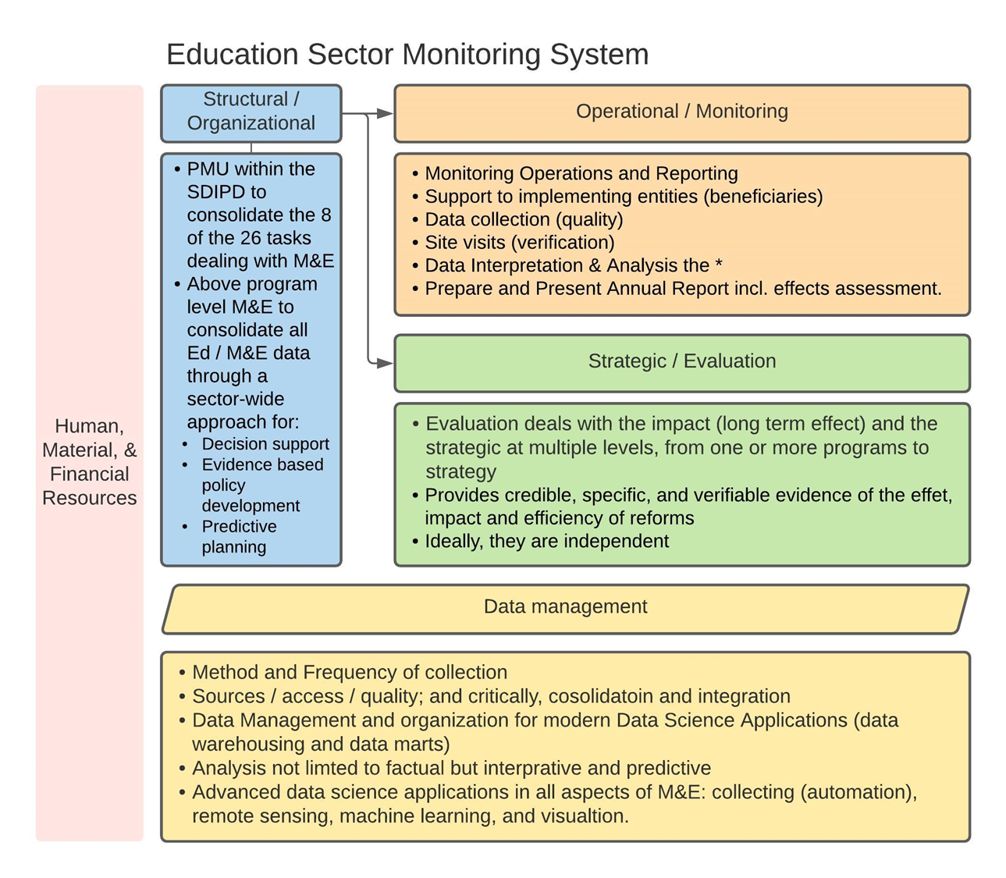
Output 5: M&E Proposal

Slide 12
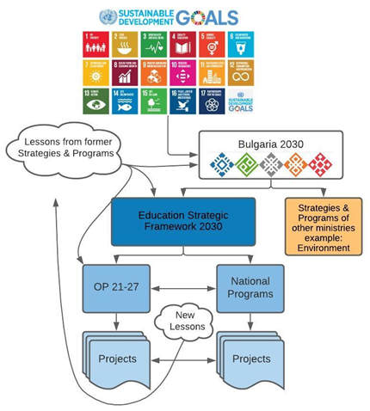
Output 7.1/7.2: Assessment of drafts of EP 21-27
The figure represents the ideal vertical integration scenario. This type of integration is not clear in EP21-27, however all recommendations in the submitted outputs reflect this results based model

Slide 13
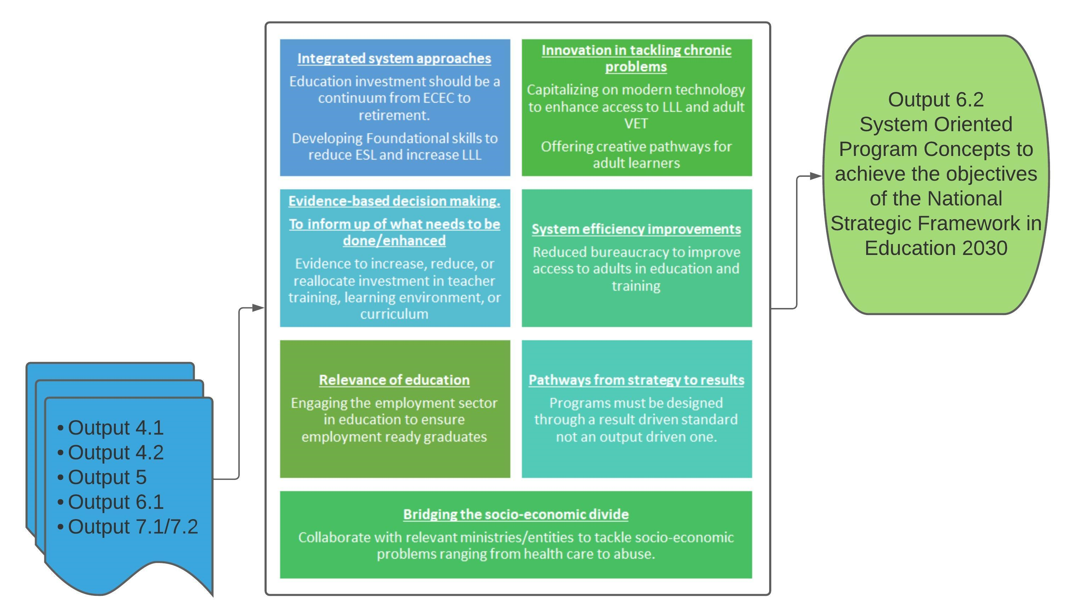
System Wide Adjustments

